Slide 1
BME Graduate Studies
Preview
Welcome to USC!
William Yang, MSBioE, MSPM
Assistant Director, Student Services
Graduate Affairs Advisor
Department of Biomedical Engineering

Slide 2
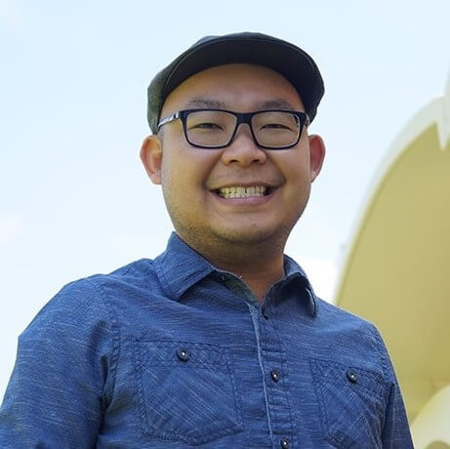
Advising
William Yang
Advises BME MS and PhD students
Born and Raised in Southern California
BS, Biological Science
University of California, Riverside
MS, Bioengineering
University of California, Riverside
MS, Project Management
University of Wisconsin, Platteville

Slide 3
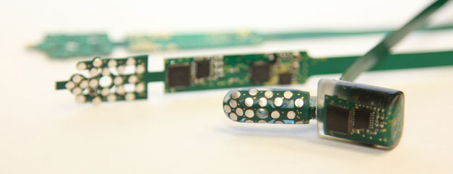
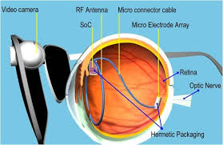
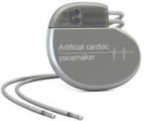
What is Biomedical Engineering?
The interdisciplinary field of Biomedical Engineering (BME) combines elements of engineering (electronics, systems analysis, mechanics, etc.) with the life sciences (biology, physiology, biochemistry, etc.) to define and solve problems in biology and medicine. Biomedical Engineers are “masters of integration.”

Slide 4
What Are The Requirements?
Undergraduate Major
Biology/Biological Sciences
Chemistry/Chemical Engineering
Neuroscience
Physics
Mechanical Engineering
Electrical Engineering
Computer Science
Pre-Med
And More!
Recommended Preparation
Pre-Med Courses
Linear Algebra
Differential Equations
MatLab
Python
+

Slide 5
BME Department at a Glance
Option in Electrical Engineering in 1963
Department founded in 1976
Oldest BME program in California
Core Faculty: >20
Specialties in neuroengineering, biosystems and biosignal analysis, medical devices and implants, bioimaging and imaging informatics, and systems cellular-molecular bioengineering
Affiliated Faculty: >50
PhD students: 130
Master students: 150

Slide 6
BME Graduate Programs
Doctor of Philosophy (PhD) in Biomedical Engineering, 60 units
Research Based
Full-Time
Average Completion Time: 5-6 years
Time Limit: 8 years
Full Funding: stipend, tuition, and health insurance
Year 1: 4 Academic + 2 Lab Rotation Courses
Year 2 & Beyond: Continuous Enrollment in Research Course

Slide 7
BME Graduate Programs
Master of Science (MS) in
Biomedical Data Analytics (BMDA) – NEW, 28 units
Biomedical Engineering (BME) - Most Popular, 28 units
Medical Imaging and Imaging Informatics (MIII), 28 units
Medical Devices and Diagnostic Engineering (MDDE), 26 units
Full- or Part- Time
Average Completion Time: 2-3 years
Time Limit: 5 years
Tuition: per unit rate
Coursework Only or Coursework + Thesis Option
Volunteer Research Opportunities
Directed Research Credits

Slide 8
Industry and Career

Slide 9
Research
Interdisciplinary
Collaborations with researchers from many majors
Experience – IMPORTANT!!!
Professional growth and development
Build your network

Slide 10
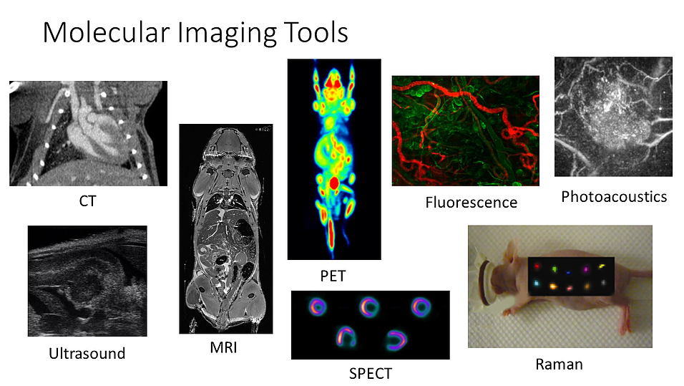
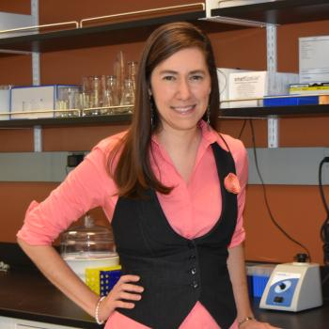
Faculty Member: Dr. Cristina Zavaleta
BA, University of Incarnate Word, Nuclear Medicine
PhD, University Texas Health Science Center, Radiological Sciences
Postdoc Stanford
Research: Molecular imaging and nanodiagnostics

Slide 11
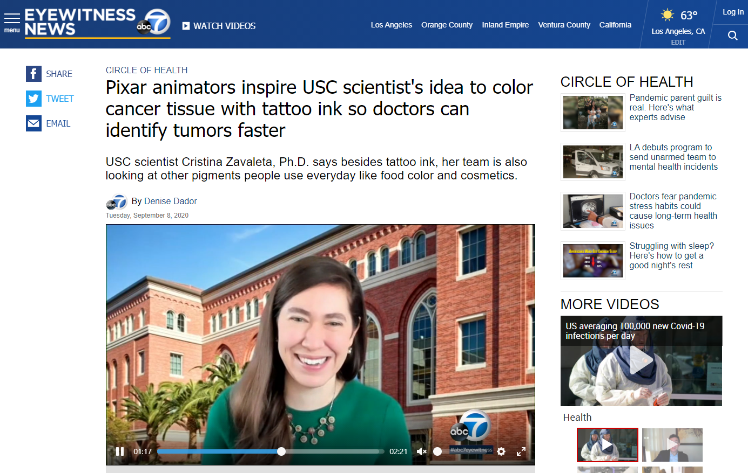
Faculty Member: Dr. Cristina Zavaleta
Source: https://abc7.com/pixar-usc-scientist-cancer-ink/6413093/

Slide 12
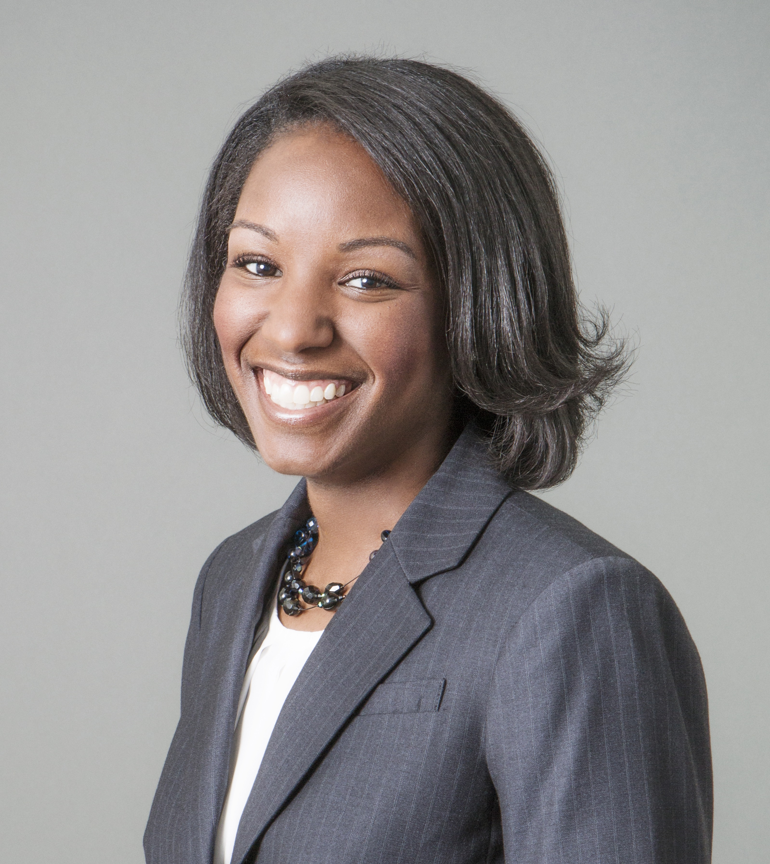
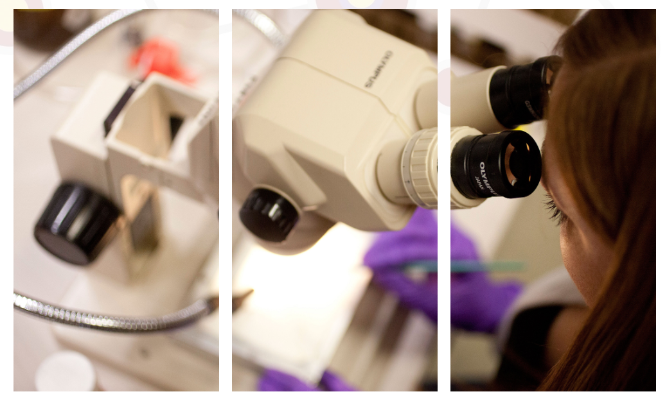
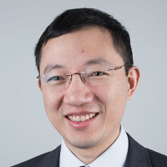
BME Faculty Members
Dr. Stacey Finley
Research: applying computational modeling to study angiogenesis, metabolism, and immunotherapy.
PhD @ Northwestern University
Dr. Keyue Shen
Research: aims to develop biologically inspired in vitro platforms to capture the scale of cell signaling in tissue microenvironments from subcellular to tissue levels, and discover novel therapeutics for human diseases.
PhD @ Columbia University

Slide 13
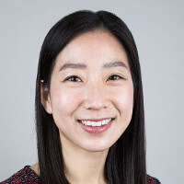
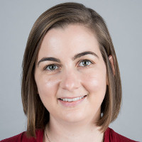
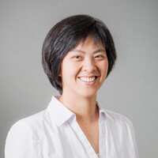
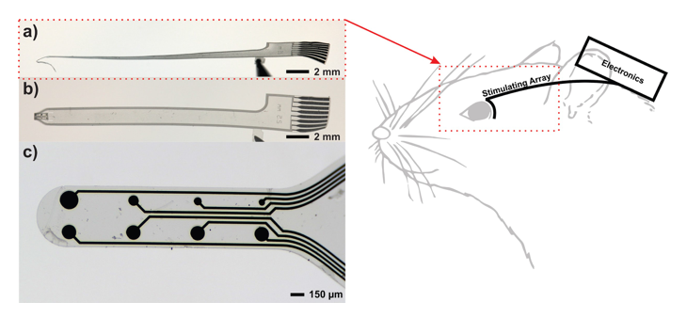
BME Faculty Members
Dr. Eun Ji Chung
Research: harnessing molecular design and self-assembly to develop nano- to macroscale biomaterials that can be utilized in medicine
PhD @ Northwestern University
Dr. Megan McCain
Research: find cures for human diseases, we need reliable models of human tissue that can be used to dynamically monitor disease progression and test drugs with reasonable throughput.
PhD @ Harvard University
Dr. Ellis Meng
Research: developing novel micro- and nanotechnologies for biomedical applications
PhD @ CalTech

Slide 14
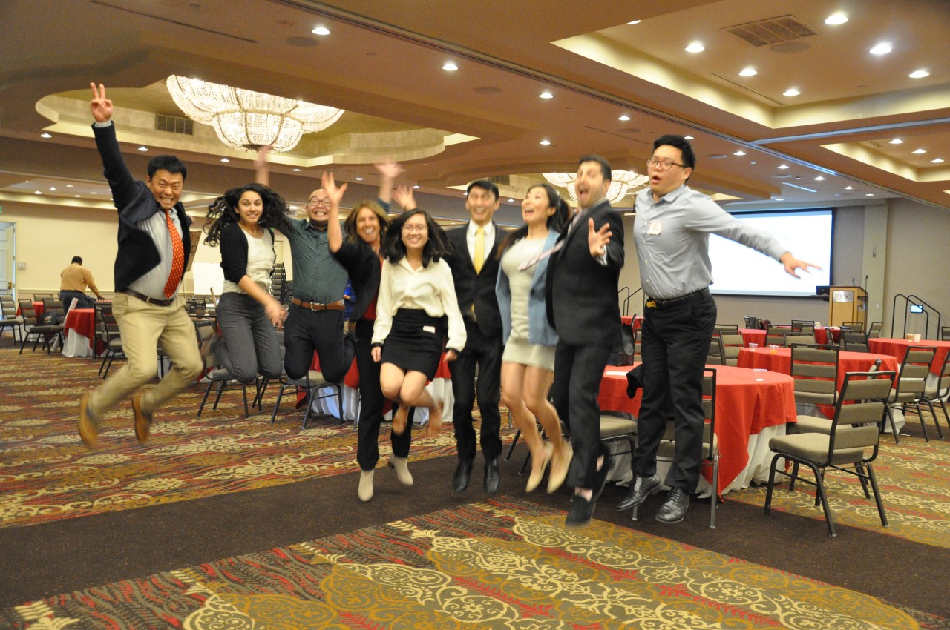
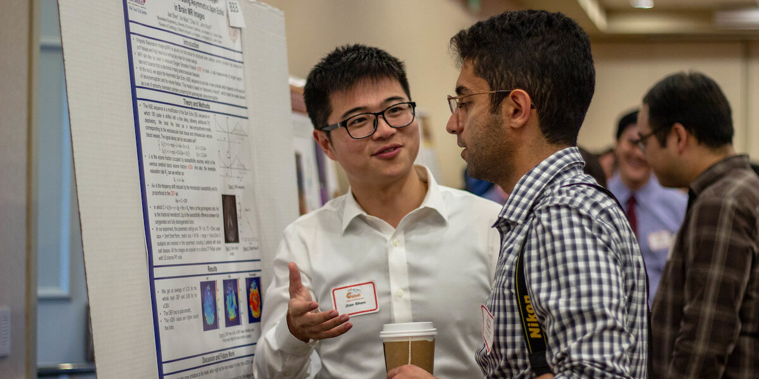
Get Involved!
Annual Graduate Research Symposium
Viterbi Graduate Student Association (VGSA)
Graduate Students of Biomedical Engineering (GSBME)
Other Student Organizations

Slide 15
It’s up to you.
Summer Undergraduate Research Experience (SURE)
https://viterbiundergrad.usc.edu/research/sure/

Slide 16
BME Graduate Studies
Preview
Welcome to USC!
William Yang, MSBioE, MSPM
Assistant Director, Student Services
Graduate Affairs Advisor
e: yangwill@usc.edu t:213.740.0344
Department of Biomedical Engineering

